Slide 1
The battle of neighborhoods
New York vs. Toronto
Hannah L. Weinberger

Slide 2
Introduction
We will describe a situation in which a person received a promotion at work, but as a result he must leave the city where he lives. This person has lived in the neighborhood for 15 years and is very fond of certain things in the neighborhood such as a certain Chinese restaurant.
Since he has no choice and he has to move to a new city. He wants to choose a neighborhood in the city that is best suited for his lifestyle he has been used to.

Slide 3
Objective
Apply a k-mean cluster algorithm to the neighborhood cluster based on their similarities in different facilities and locations.
For the purpose of success, we will try to understand the optimal cluster size by conducting an in-depth data analysis on different clusters and try to discern their similarity.

Slide 4
Flow Chart
Data Processing
Creating the Data Frames – finding zip codes, Latitude & Longitude
Using Foursquare to get he venues for each area
Getting all Unique venues
One Hot transformation for all venues on all locations
Model Building
Finding the optimal Cluster number using Elbow Method and Silhouette method for K-means
Fit K-means
Model Validation

Slide 5
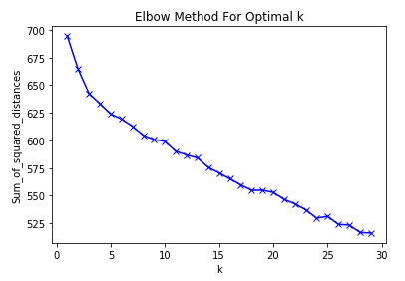
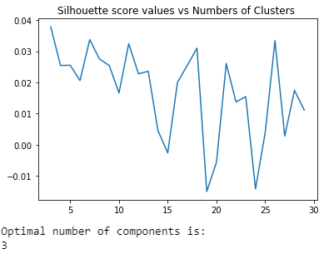
Optimal # of clusters
Elbow Method
Silhouette method

Slide 6
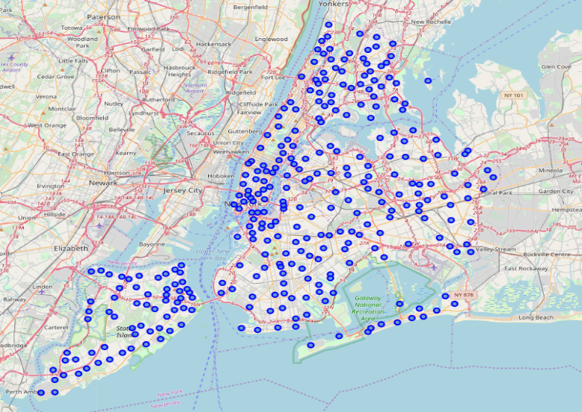
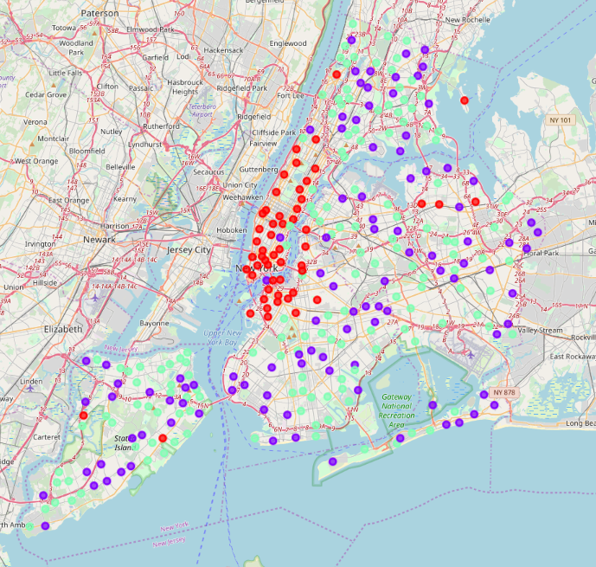
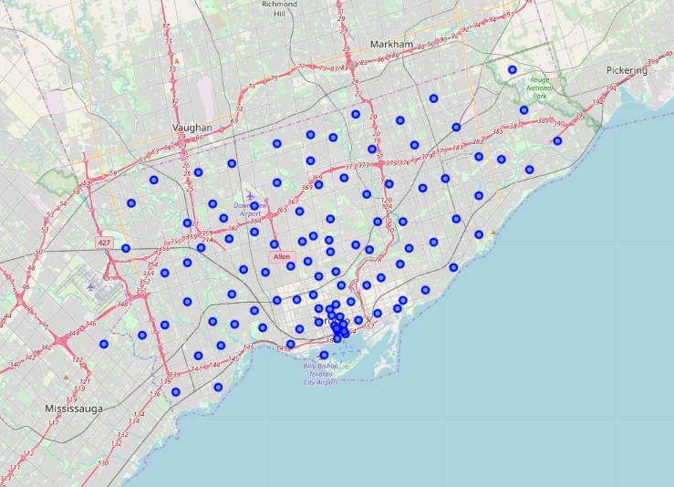
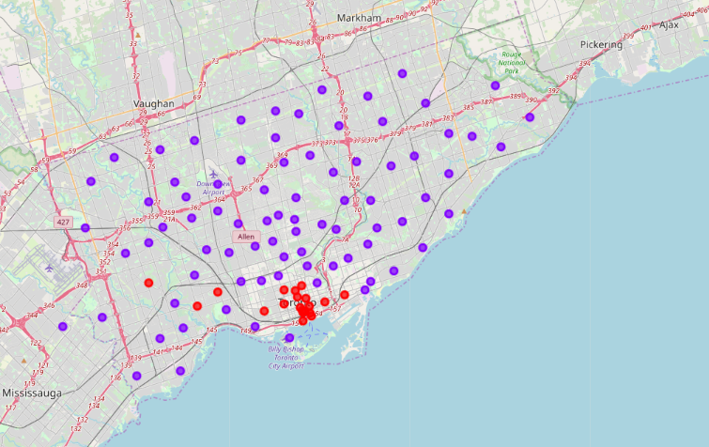
Visualization
Before Clustering
After Clustering

Slide 7
Conclusion
The project work was only done on the New York and Toronto zip codes. each of which has 150 features even after reducing dimensions via PCA. The problem is that we have a huge feature area but a limited number of examples. We can collect data from United States and Canada, which will make our dataset a good balance.
There can be algorithms from other files that can work better. DBSCAN seems to fit our data very well.
We can summarize everything, and convert to a neighborhood recommendation app.

